Slide 1
Decision Table Based Testing

Slide 2
Scenario
We have a strict policy about cashing checks. Bad checks are a nuisance to us and cost us a lot of money, so we're pretty careful about it. For us to cash a check the teller first sees if the person has a valid account number with us. If they do, we'll cash the check with just their signature. The only other kinds of checks we cash are government checks and only if the person has photo ID. They don't need an account number for that.
Design the decision table for the Check Cashing Policy!

Slide 3
Road to Decision Table
Conditions:
Customer has valid account number (Values = Y, N)
Check is a government check (Values = Y, N)
Customer has photo ID (Values = Y, N)
Actions:
Cash check with signature
Cash check
Don't cash check
Number of rules: 2 values * 2 values * 2 values = 8 rules.

Slide 4
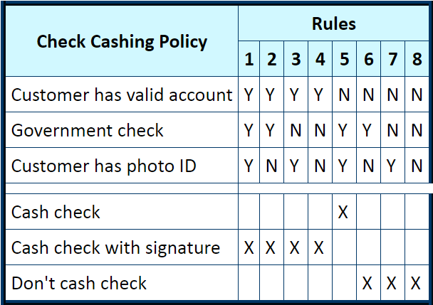
Solution

Slide 5
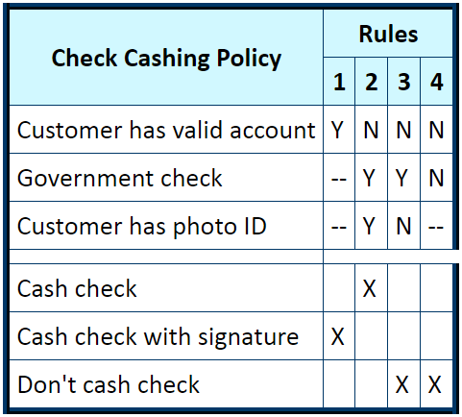
After Simplifying

Slide 6
GooD LucK !!!

